Slide 1
Ego (Personal) Network Properties
Size
  Degree, In-Degree,Out-Degree, Activity
  Layer organization (Dunbar)
Clustering
  Clustering Coefficient (Density)
  Effective Size
  Efficiency
Composition
  Tie Strength (Average, St. Deviation, multiplexity)
  Composition & Diversity
  Homophily

Slide 2
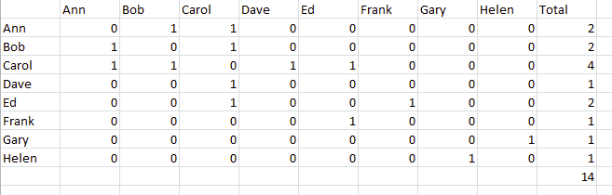
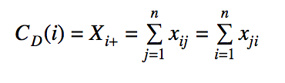

Degree
Vertex Activity

Slide 3
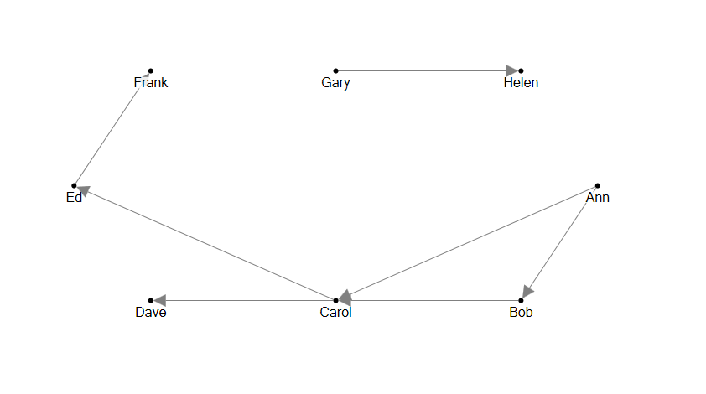
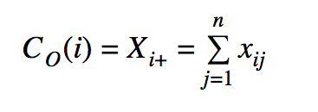
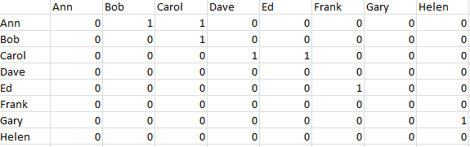
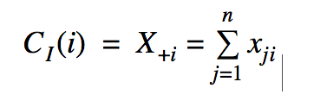
In and Out Degree
Out-Degree
  High out-degree people can “influence” more people
In-Degree: Popularity
  High In-degree people are contacted by lots of other
  Are affected (more reachable) by lots of others
j
i

Slide 4
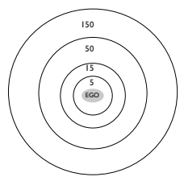
How are ego networks organized?
Anthropologist Robin Dunbar:
  Ego-networks are organized by layers
    “Closer” more intimate layers
    “Farther” less intimate ones
  Closer layers are smaller
  Farther layers are larger
  Different relationships entails different “maintenance costs”
  Costs determine the number of persons in each layer
    Support clique
    Sympathy group
    Affinity group
    Active Network

Slide 5
How are ego networks organized?
Anthropologist Robin Dunbar:
  Support clique (~ 4 - 5)
    Your most intimate “best” friends and kin you can rely on them for crises and emergencies
  Sympathy group (~12 - 15)
    Good friends that can provide some services and that you contact often
  Affinity group (~ 45 - 50)
    More casual, “hang out” friends and extended relatives
  Active Network (~120 - 150)
    Total number people you contact or see at least once a year, acquaintances

Slide 6
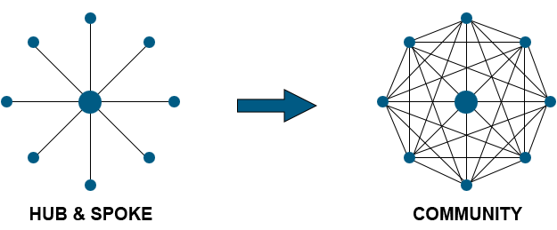
Clustering
How big is a person’s network, really?
With clustering, friends can be friends of your other friends, so redundant.
If one big clique, a person may really just have 1 information source.
Triadic closure & transitivity

Slide 7

Clustering Coefficient
Size
  N = 7, E = 6
Avg. Alter Degree = 2E/N = 2*6/7 = 1.7
Clustering Coefficient (CC):
  Density of ego network
  CC = 2E/(N(N-1)) = (2*6)/(7*6) = .286
  Redundancy: CC(N-1)
    .286(6) = 1.7
  Effective Size (ES):
    N - (2E/N) = N - CC(N-1) = N - Av. Alter Degree
    7-(2*6/7) = 7 - .286*6 = 7- 1.7 = 5.285
  Efficiency: ES/N = 5.285/7 = .755

Slide 8
Composition
Diversity
  Heterogeneity vs. homogeneity among alters on some nodal trait
Vertex Traits
  Categorical: Race, Sex, Age, Education, Class, Occupation
  Continuous: Attitudes, Tastes, Social Psychological Scales, Mental Health, Network Size
  Blau - Dimensions of Association
Ego Network (Tie) Traits
  Tie strength, alter network size, tie traits (e.g. kin, co-workers, acquaintances, friends)

Slide 9
Socio-Demographic Diversity
Age (Life course stage)
Gender
Race
Occupation
Education

Slide 10
Measuring Diversity: Categorical Variables
Count of number of categories represented in an ego network
Proportion in various categories (e.g. proportion White, Female)
Diversity on categorical alter traits (sex, race, religion): Index of qualitative variation (IQV):
  IQV = H / (1 - 1/r) where r is the number of different types of categories
    So let’s say your network is 25% black and 50% white 10% Asian and 15% hispanic
    Then IQV for race/ethnic ties is:
    (1 - 0.25² - 0.50²- 0.10²- 0.15²) ÷ (1 - 1/4) = 0.87 Very diverse!
    But if was 0% black and 80% white 15% Asian and 5% hispanic
    (1 - 0² - 0.80²- 0.15²- 0.05²) ÷ (1 - 1/4) = 0.45 No so much
Composition on tie type
  kin/family, friends, acquaintances, co-workers, neighbors.

Slide 11
Alternative Diversity Measures
Shannon Entropy
-1 * (Sum(pi * log(pi))
Pi = count of alters in category i
Varies from 0 (homogeneity) to 1 (heterogeneity)

Slide 12
Measuring Diversity: Continuous Measure
Mean: central tendency in the ego network
Standard Deviations (or other measures of dispersion): diversity
  When st. dev. ~ 0 → homogeneity
Can compute diversity for both
  Vertex traits of contacts: age, behaviors (drinking, smoking), educational attainment (in years)
  Tie traits: multiplexity, tie strength (e.g. closeness), number of types of support

Slide 13
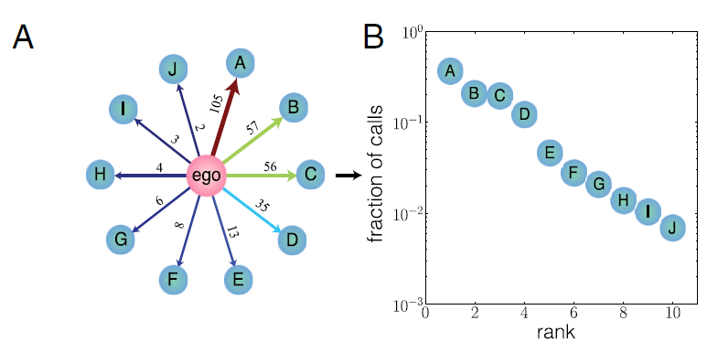
Tie Strength Distribution & Social Signatures
Definition of “social signature”
  The relative distribution of edge weights across an egocentric network
  Especially, ranked proportion of interaction frequency within a given window of time
  Like degree distribution for egonets
Calculation procedure
  Define time window and bins for weighting
  Compute weights for each ego-alter edge, as well as the total weight across edges
  Rank edges by weight (descending order)
  Compute the proportion of total weight for each edge as a function of its rank
For now we will use instead the means and st. deviation of the edge weight distribution.
Saramäki, et al. 2014. “Persistence of Social Signatures in Human Communication.” PNAS 111(3): 942-947. Fig. 1.
Notes:
Average weight is function of net size and activity level. Could also just compute total sum of weights to get activity

Slide 14
Network Composition & Homophily
Composition measures: IQV (or entropy) for quantitative variables; mean and st. dev. of alters on some trait
Homophily measures for Continuous Variables: Similarity/Difference Scores
  Compare each alter to the ego on that trait
  homophily = similarity
  Sum of the absolute value of the differences across all ties in ego network
  Alternative: Compute mean of trait among alters; Compute difference score
Homophily measures for Categorical Variables
  Proportion same
  Mixing Matrices (on vs. off-diagonal)
  EI Score

Slide 15
Composition Measures
Can compute composition/diversity measures on
  Nodal traits (gender, race, attitudes, status)
  Nodal traits derived from network position (degree)
  Tie traits (kin, co-workers, friends)
  Tie traits derived from network interaction (tie strength)
For tie traits can not compute homophily measures
  Note: Reciprocity is differential directed tie strength
For nodal traits can compute both composition and homophily measures

Slide 16
Measuring Homophily: EI Scores for Categorical Variables
EI = (E - I)/(E+I)
E = number of ties that are different from ego
I = number of ties that are similar to ego
E+I = total ties.
Varies from -1 to +1
-1 indicates homophily
+1 indicates heterophily - ties only to people not like ego
0 indicates no association

Slide 17
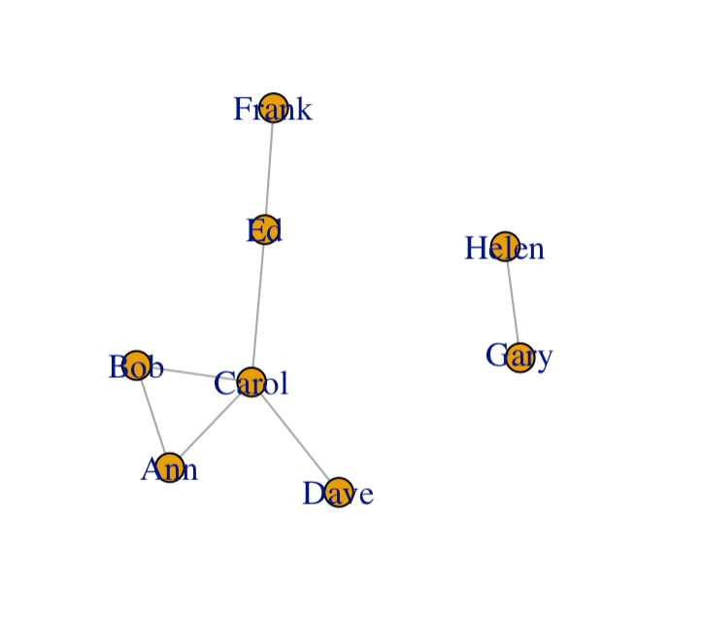
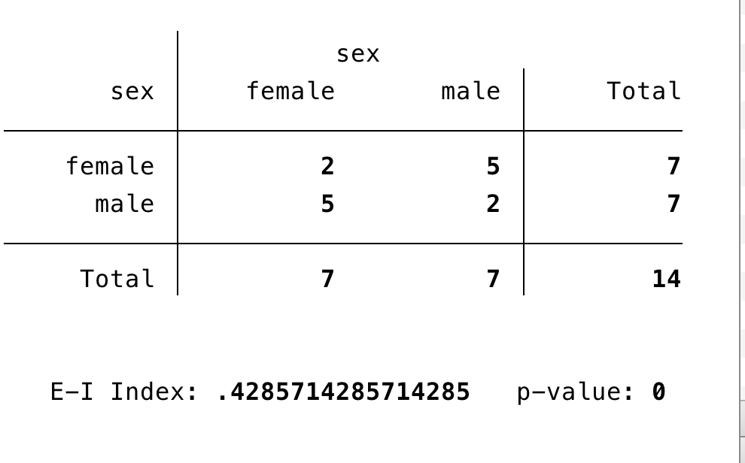
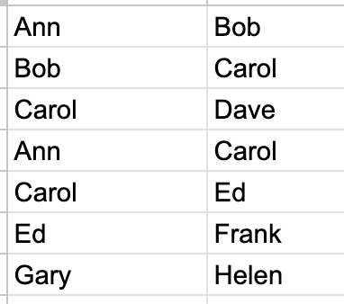
Mixing Matrix
EI = (E - I)/(E+I)
Notes:
(10-4)/14
5-2 / 7

Slide 18
Summary: Ego Network Properties
Size (Degree)
Clustering
  Clustering Coefficient
  Redundancy, Effective Size, Efficiency
Composition
  Diversity/Composition
  Homophily

Slide 19
Tie strength
Tie strength is defined as a combination of multiple tie properties:
  Duration
  Time spent together
  Emotional intensity
  Intimacy and confiding
  Frequency of interaction
    Which ones are the best indicators of tie strength empirically?
  “The strength of a tie is a (probably linear) combination of the amount of time, the emotional intensity, the intimacy (mutual confiding) and the reciprocal services which characterize the tie” (Granovetter 1973: 1361)
Average tie strength
Standard deviation of average tie strength

Slide 20

Ego networks: Some propositions (Marsden 1987)
The larger the ego network:
  The more diverse, less homophilous, more open
Smaller ego networks:
  Tend to be more clustered , less diverse
The more diversity
  Less homophily
The higher average tie strength
  The more clustering, less diversity
The more proportion kin
  The more homophily, less diversity, more clustering

Slide 21
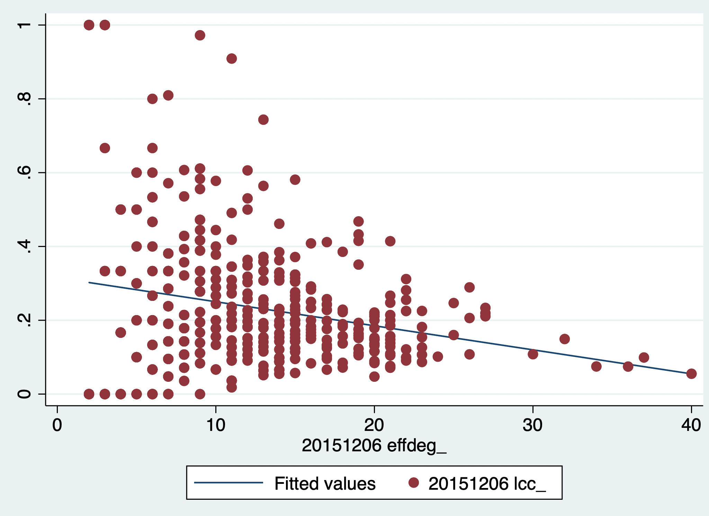

Slide 22
Nodal Trait Clustering
Homophily/Assortativity - nodal trait clustering at level of dyads
  Nodes that are connected by an edge are likely to be more similar than non-connected nodes
  Ego Network: Low (negative) EI scores
Segmentation (segregation) - nodal trait clustering at the whole network level
  Few ties between clusters (segments), most ties within clusters
Macro traits associated with social inequalities (race, gender, class, occupation, religion, education, age, income) → micro patterns of social interaction (ties within and between categorical groups)
  Can also look at variation in behaviors (e.g., health) and tastes (e.g., musical genres)
  And network traits of nodes nodes (degree, clustering)

Slide 23
Detecting Nodal Trait Clustering
Whole network -- dyadic assortativity
  Dyads in which the two nodes are similar are more likely than chance (given distribution of trait among all nodes in the network)
If we randomly placed ties between nodes, would we see assortativity
For example, if 50-50 distribution, 50% of ties will be assortative
If 80-20 distribution, 68 % assortative.
Can compare observed assortativity to predicted under a model that maintains nodel trait distribution.
But random placement will lead to change in degree distribution and degree assortativity
Random placement without change in degree distribution, degree correlation, and vertex trait distribution

Slide 24
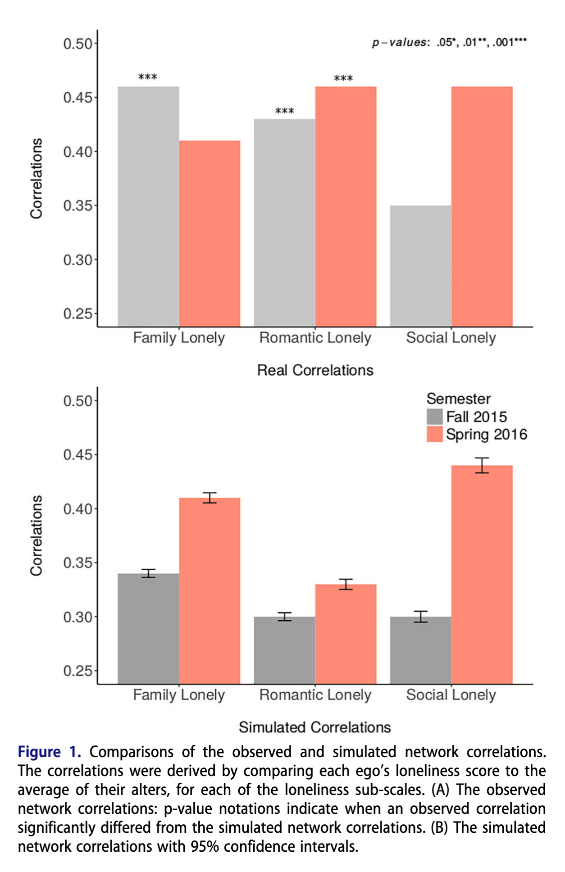
Loneliness Example
3 dimensions of loneliness: familial, social, romantic
Ties in Fall 2015, Spring 2016
Compute correlation between loneliness of i and average loneliness of i’s alter
Rewire networks 1000 times preserving degree distribution and correlation.
Compute loneliness correlation and average correlation across 1000 networks
Compare correlations

Slide 25
Sources of Homophily
Measures indicate clustering on a nodal trait
  Nodes that are (more) similar are more likely to have edges between them
  Ego Network: Low (negative) EI scores
Many reasons for this network clustering
  Induced Homophily
  Choice Homophily -- Bias

Slide 26
Theories of Homophily
Personal preferences influencing choice of alters (choice homophily - Lazerfeld & Merton)
  People likely to associate with people who are similar to them
Composition of population from which alters are drawn (induced homophily - Blau)
  Composition of social foci in which ego interacts with others (Feld)
Size (degree) of ego’s network (Marsden)

Slide 27
Preference
Birds of a feather flock together -- but why?
  Comfort
  Proximity because of physical segregation
  Prejudice and discrimination (animous, unconscious, statistical)
  Identities and salience -- seek out those who are similar
Usually assumes preferences operate at the time of tie formation
  Could also operate during tie evolution (maintenance) and tie decay (dissolution)
Assumes similarities and differences are visible (can be easily known)
Issue of multiform heterogeneity (Blau)
  Because dimensions of stratification are correlated (e.g, religion and race), homophily on a nodal trait could indicate (1) preference for people with that trait or (2) preference for people with another trait that is highly coupled with that trait
Preference for those who are different -- heterophily ?????
Notes:
visibility

Slide 28
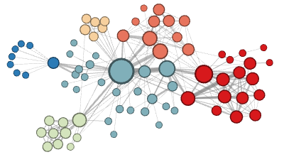
Why do your ego networks look they way they do?
The composition of your ego network is likely biased
  How are your ego networks biased?
    Some kinds of people are over-represented in your ego-network
    Some kinds of people are under-represented in your ego network
    The people who are over-represented are more likely to be similar to you
    The people who are under-represented are more likely to be dissimilar to you
      These last two things are the basis of homophily*
*McPherson, M., Smith-Lovin, L., & Cook, J. M. (2001). Birds of a feather: Homophily in social networks. Annual Review of Sociology, 27(1), 415-444.

Slide 29
Why do your ego networks look they way they do?
In what ways are your networks biased toward homophily?
  According to pretty much any social distinction we can think of*
    Gender
    Race/Ethnicity
    Education
    Age
    Occupation/Income
  These are what Peter Blau called “dimensions of association”
    Some of these are “categorical”
      Like race , gender or occupation
    Some are “continuous”
      Like age, education or income

Slide 30

Why do your ego networks look they way they do?
Why are your ego networks biased toward homophily?
  One obvious source of bias is what has been called* choice homophily
    You like to hang out with people who are similar to you (regardless)
  One non-obvious source of bias is what has been called* induced homophily
    The social context (nation, state, organization) where you reside determines the people who are available for you to hang out with
*McPherson, J. M., & Smith-Lovin, L. (1987). Homophily in voluntary organizations: Status distance and the composition of face-to-face groups. American Sociological Review, 370-379.
Peter Blau (1918 - 2002)

Slide 31
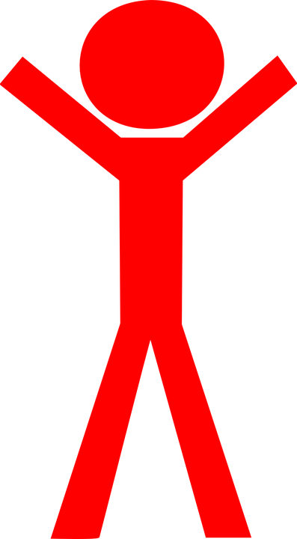
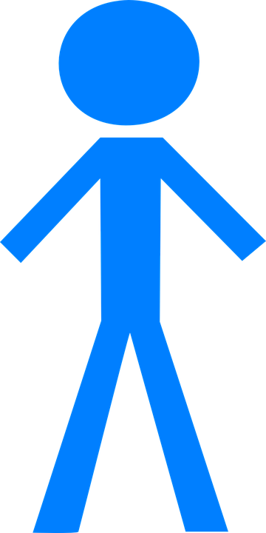
Why do your ego networks look they way they do?
The World
Your ego network
Peter Blau (1918 - 2002)
Unbiased
Biased

Slide 32
Why do your ego networks look they way they do?
The World
Your ego network
Peter Blau (1918 - 2002)
Unbiased
Biased

Slide 33
Why do your ego networks look they way they do?
The World
Your ego network
Peter Blau (1918 - 2002)
Unbiased
Biased

Slide 34
Why do your ego networks look they way they do?
The World
Your ego network
Peter Blau (1918 - 2002)
Unbiased
Biased

Slide 35
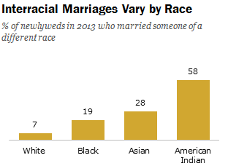
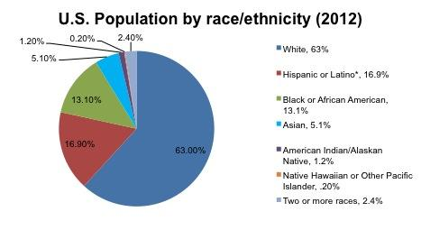
Blau’s rules: Group size effects
If a categorical dimension divides the population into two or more groups:
  Rule 1: Members of numerically smaller groups will be more likely to have relations with outgroup members
  Rule 2: Members of numerically larger groups will be more likely to have relations with ingroup members
    These are called group size effects

Slide 36
Social Foci
Key insight: People do not form ties at random, but rather they form ties through settings where they meet and interact with others
Social foci
  “ a social, psychological, legal, or physical entity around which joint activities are organized (e.g., workplaces, voluntary organizations, hangouts, families, etc.” (Feld 1981: 1016)
Tie formation via affiliations (e.g., clubs, religious organizations, classes)
Foci vary in constraint (time and energy required) and size
People can belong to multiple intersecting foci
  Can be cross-cutting or overlapping
Composition of foci → composition of ego networks
  Segregated foci → homophily
  Integrated foci → reduce homophily

Slide 37
Focused organizations of social ties
Foci vary around several dimensions
  Levels of “constraint”
    Time and energy that they require
  Size
Foci may emerge from pre-existing relations
  Friends form clubs, participate in common activities
Individuals generally belong to multiple intersecting foci
  “Cross-cutting” circles
  Clustering at the ego-network level may be the result of constraining overlapping foci

Slide 38

Focused organizations of social ties
One observation:
  Often social relations are organized around “circles,” or “common activities”
  These “foci” may themselves be a primary driver of which relations show up in people’s networks
What is a “focus”?
  “ a social, psychological, legal, or physical entity around which joint activities are organized (e.g., workplaces, voluntary organizations, hangouts, families, etc.” (Feld 1981: 1016)

Slide 39

Focused organizations of social ties
This suggests two new mechanisms for where ties come from:
From circle to relation
From common activity to relation

Slide 40
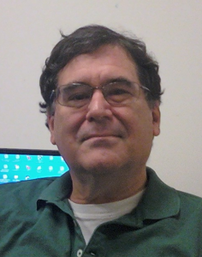
Why do your ego networks look they way they do?
Church
Family
School
You
Scott Feld
Unbiased!

Slide 41
Why do your ego networks look they way they do?
Church
Family
School
You
Scott Feld
Unbiased!

Slide 42
Why do your ego networks look they way they do?
The typical settings within which you interact as reference for bias:
  Feld Rule: If the settings within which you interact are biased towards a particular categorical or continuous dimension of association your ego-network will reflect that bias
    Feld referred to these settings as social foci
    Therefore, this is the called the focus effect
      Foci make homophily happen via segregation
    Conversely,
      Desegregated foci reduce homophily
Scott Feld

Slide 43

Why do your ego networks look they way they do?
The World
Your ego network
Small
Large
Peter Marsden
More biased
Less Biased

Slide 44
Why do your ego networks look they way they do?
Overall, larger ego networks should be more diverse
  Regardless of preferences for choice homophily
    At some point you run out of ingroup alters!
But this effect should depend group size effects
  In general, minorities should get more “bang from their buck” (in terms of diversity) from network size
    Can you tell why?
Peter Marsden

Slide 45
Why do your ego networks look they way they do?
Overall, larger ego networks should be more diverse
  Regardless of preferences for choice homophily
    At some point you run out of ingroup alters!
But this effect should depend group size effects
  In general, minorities should get more “bang from their buck” (in terms of diversity) from network size
    Can you guess why?

Slide 46
Why do your ego networks look they way they do?
Overall, larger ego networks should be more diverse
  Regardless of preferences for choice homophily
    At some point you run out of ingroup alters!
But this effect should depend group size effects
  In general, minorities should get more “bang from their buck” (in terms of diversity) from network size
    Can you tell why?
A
B

Slide 47

Why do your ego networks look they way they do?

Slide 48

Blau’s rules: Multiform heterogeneity effects
Example:
  In the U.S. there are systematic correlations between religion and race
This means that:
  Choosing contacts based on race leads to biases in the representation of people of certain religions at the micro-structural level (And vice-versa)
Accordingly:
  Can’t conclude that people prefer same (race/religion) contacts from micro-level observations of homogeneity!

Slide 49
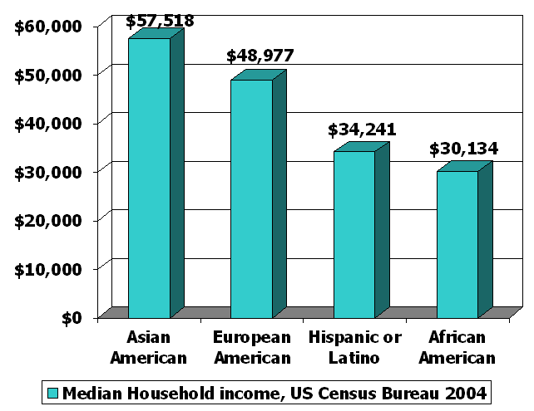
Blau’s rules: Multiform heterogeneity effects
This applies to any correlation between dimensions of association
  Same race associational preference may lead to higher/lower representation of people different social classes at the micro-structural level
With negative correlations it goes the other way
  More diversity at the micro-level that we would expect
    E.g. Age and education

Slide 50
Summary
Homophily can be observed at both the ego and dyad level
  Ego network: composition
  Dyad: Similarity between vertices connected by an edge
Dyad Processes -- tie formation
  Preference/Choice
  Induced: random formation within skewed population distributions
  Social Foci: formation through affiliations with skewed population distributions
  Network Size: The more choices a person makes (ie. the larger their network) the more the composition of their network will represent the population distribution.
No triadic processes
  Triadic closure → increases homophily. WHY?
Formation or decay?

